Slide 1
Training Program Overview
Day 1 - SQL Server 2012 & SQL Azure
Day 2 - Visual Studio 2012
Day 3 - Application LifeCycle Management and
Team Foundation Server

Slide 2
SQL Server 2012 & SQL Azure
Day 1

Slide 3
New Features in Database Engine
Programmability Enhancements
Scalability & Performance Enhancements
Security Enhancements
Backup and Restore Enhancements

Slide 4
New Features in Database Engine
Sequences
Data Paging
Conversion Functions
Logical Functions
Date/Time Functions
String Functions

Slide 5
New Features in Database Engine
Sequences
Data Paging
Conversion Functions
Logical Functions
Date/Time Functions
String Functions

Slide 6
Sequence
New construct to generate numeric sequences
Ability to set min and max values
Cycle will set the current value to the min value when the max value is reached
Future values can be cached minimizing disk IO
Table: sys.sequences

Slide 7
Sequence
CREATE SEQUENCE
ALTER SEQUENCE
DROP SEQUENCE
NEXT VALUE FOR sp_sequence_get_range

Slide 8
Sequence
CREATE SEQUENCE Schema.SequenceName AS int INCREMENT BY 1 ;
-2,147,483,648 to 2,147,483,647
CREATE SEQUENCE Test.CountBy1 AS int START WITH 1 INCREMENT BY 1 ;
INSERT INTO Test.Orders (OrderID, Name, Qty) VALUES (NEXT VALUE FOR Test.CountBy1, 'Windows Phone', 2);

Slide 9
OFFSET and FETCH
Allows for server side data paging for the web.
OFFSET and FETCH are arguments of the ORDER BY clause
OFFSET - Number of rows to skip
FETCH - Number of rows to return

Slide 10
OFFSET and FETCH
-- Skip the first 5 rows from the sorted result set and return all remaining rows.
SELECT DepartmentID, Name, GroupName FROM HumanResources.Department ORDER BY DepartmentID OFFSET 5 ROWS;

Slide 11
OFFSET and FETCH
-- Skip 0 rows and return only the first 10 rows from the sorted result set.
SELECT DepartmentID, Name, GroupName FROM HumanResources.Department ORDER BY DepartmentID OFFSET 0 ROWS FETCH NEXT 10 ROWS ONLY;

Slide 12
PARSE, TRY_PARSE & TRY_CONVERT
PARSE - Parse a string to number or datetime
When cannot parse, returns error
Uses .Net CLR
TRY_PARSE - Similar to Parse. On error returns NULL instead.
Still Uses the .Net CLR
CONVERT - Cast a value to a specified data type.

Slide 13
Logical Functions - IIF
Immediate IF or Inline IF
Takes a boolean expression and returns one of two values.
Shorthand for CASE
Has the same limitations as CASE
- Can only be nested to 10 levels
IIF(@Parameter=ColumnName, 1, 0)

Slide 14
Logical Functions - CHOOSE
Returns the item at the specified index from a list of values
CHOOSE ( index, val_1, val_2 [, val_n ] )

Slide 15
*FROMPARTS
DATEFROMPARTS (year, month, day)
DATETIME2FROMPARTS (year, month, day, hour, minute, seconds, fractions, precision)
DATETIMEFROMPARTS (year, month, day, hour, minute, seconds, milliseconds)
DATETIMEOFFSETFROMPARTS (year, month, day, hour, minute, seconds, fractions, hour_offset, minute_offset, precision)
SMALLDATETIMEFROMPARTS (year, month, day, hour, minute)
TIMEFROMPARTS (hour, minute, seconds, fractions, precision)

Slide 16
CONCAT
Concatenates strings together.
NULLs are automatically converted to empty strings.
Can pass other data types for concatenation.
CONCAT ( string_value1, string_value2 [, string_valueN ] )

Slide 17
FORMAT
Simplifies the string formatting of dates and other data types
No more memorising numeric predefined format values
Returns a string
Uses .Net CLR
FORMAT ( value, format [, culture ] )

Slide 18
THROW
Reduces the need to use RAISEERROR in TRY/CATCH blocks
Can provide custom error messages
Always uses severity level 16

Slide 19
Spatial Data Enhancements
Using Circular arcs the locations on the earth can be represented more accurately e.g. curved roads or water bodies.
CircularStrings - Collection of 0 or more continuous arc segments
LineStrings - Collection of 0 or more continouous lines
CompoundCurve - Collection object of CircularStrings & LineStrings
CurvePolygon - 4 or more points and same start and end X&Y coordinates
SELECT * FROM table t WITH(SPATIAL_WINDOW_MAX_CELLS=1024) WHERE t.geom.STIntersects(@window)=1;

Slide 20
Scalability & Performance Features
Columnstore Indexes
Online Index: XML, varchar(max), nvarchar(max) and varbinary(max)
FILESTREAM FileGroup Can contain multiple files
CREATE NONCLUSTERED COLUMNSTORE INDEX CSIDT DemoTable(Column1, Column2, Column3)

Slide 21
Security Enhancements
To enhance role separation, BUILTIN\administrators and Local System (NT AUTHORITY\SYSTEM) are not automatically provisioned in the sysadmin fixed server role. Local administrators can still access the Database Engine when in single user mode.
SQL Server now supports Managed Service Accounts and Virtual Accounts when installed on Windows 7 or Windows Server 2008 R2.
The protection of operating services under a per-service SID is now extended to all operating systems.
New GRANT, DENY, and REVOKE permissions to the CREATE SEQUENCE permission.
and 18 more for CONTROL/VIEW DEFINITION/TAKE OWNERSHIP/REFERENCES/ALTER/ALTER ANY SERVER ROLE, CREATE SERVER ROLE, ALTER ANY AVAILABILITY GROUP, CREATE AVAILABILITY GROUP, ALTER ANY EVENT SESSION
User-defined server roles: CREATE/ALTER/DROP SERVER ROLE with ADD MEMBER
IS_ROLEMEMBER
DEFAULT SCHEMA FOR A WINDOWS GROUP
HASHBYTES function now supports the SHA2_256, and SHA2_512 algorithms.

Slide 22
Backup & Restore Features
Backup and Restore with Windows Azure Blob Storage Service
Flexible, reliable off-site storage
The maximum backup size supported is 1 TB.
Use the WITH COMPRESSION option
Set the access level for Windows Azure Blob container to private
BACKUP DATABASE AdventureWorks2012 TO URL = 'https://mystorageaccount.blob.core.windows.net/mycontainer/AdventureWorks2012_1.bak' URL = 'https://mystorageaccount.blob.core.windows.net/mycontainer/AdventureWorks2012_2.bak' WITH CREDENTIAL = 'mycredential', , COMPRESSION, STATS = 5; GO
IF NOT EXISTS (SELECT * FROM sys.credentials WHERE credential_identity = 'mycredential') CREATE CREDENTIAL mycredential WITH IDENTITY = 'mystorageaccount' ,SECRET = '<storage access key>' ;
Notes:
http://technet.microsoft.com/en-us/library/jj919148.aspxhttp://www.windowsazure.com/en-us/develop/net/how-to-guides/blob-storage/

Slide 23
SQL Azure
Cloud Database as a Service
SQL server Authentication only
All tables must have a clustered index before data can be inserted
Replication via BCP or SQL Data Sync Tool
Data Migration via SSIS (on site), BCP, and SQLBulkCopyAPI
Connect via SQL Server 2008 R2 Management Studio, SQLCMD, VS2012, ADO.NET
No "USE" command, Log shipping or Database Mirroring
Notes:
http://news.softpedia.com/news/SQL-Azure-vs-SQL-Server-Comparison-Available-141865.shtml

Slide 25
SS Data Tools
Day 2

Slide 26
SSDT
Online Database development with SSMS like tree view in Server Explorer
Import from existing database, snapshot of DACPAC project
Intellisense support across all the database object files
New designer tool for visual experience
Refactoring table names, field names, etc. without losing data
Navigation tools for offline development in T-SQL Editor
Errors caused immediately show up in the Error list pane and are platform specific
Previewing database updates with an option to publish on target database
Schema comparison between current project and existing state of the database
Option to sync the changes once schema comparison is reviewed
Online vs Offline Project Development

Slide 27
SSDT
DACPAC file
SQL Script file
SQL Azure
Previous versions: SQL Server 2005, SQL Server 2008/2008 R2

Slide 28
Practical Sessions Day 2

Slide 31
Application Lifecycle Management
Day 3

Slide 32
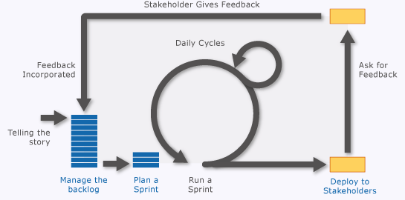
Application LifeCycle Management

Slide 33
Tools for managing the application lifecycle
PowerPoint Storyboarding: You can quickly illustrate a user story, requirement, or experience by using PowerPoint Storyboarding. With this tool you can build a storyboard from a collection of pre-defined storyboard shapes, capture existing user interfaces and customize the layouts of your web pages or phone application, as well as link the storyboard to a work item stored in Team Foundation Server.
Product backlog: The product backlog page shows a single view of the current backlog of work that can be dynamically re-ordered and grouped. Product Owners can quickly prioritize work and outline dependencies and relationships.
Sprint backlog and team capacity: The sprint backlog page reflects in real time the data you input that includes work items assigned to the iteration path, and specifying dates, individual work capacity, and work interruptions both for the team and individuals. Teams can get instant feedback on the rate of burndown and where they are over capacity.
Task board and burndown chart: As a daily practice, the team can view and update the task board to reflect the status of work items visually. The team sees the progress they are making against each product backlog item and can quickly focus on remaining work. Also, integrated into the task board is a real-time burndown chart of the remaining work in the team’s sprint.
Request Feedback and Microsoft Feedback Client: The Request Feedback and Microsoft Feedback Client tools enable teams to engage stakeholders to provide frequent and continuous feedback. The feedback client enables stakeholders to directly interact with working software while recording rich and actionable data for the team in the background through action scripts, annotations, screenshots, and video or audio recordings.

Slide 34
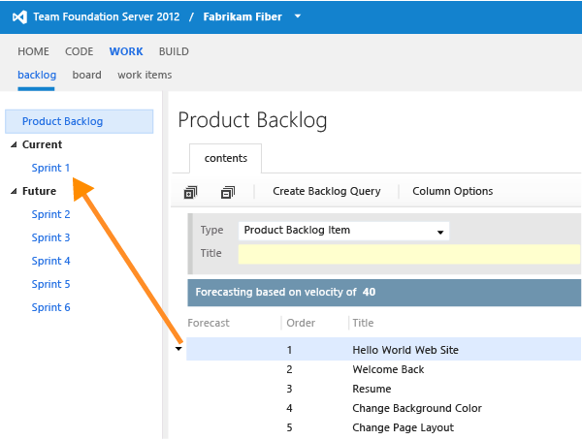
Managing ALM - Product Backlog

Slide 35
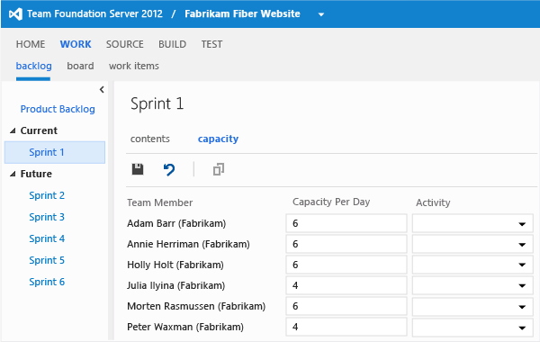

Slide 36
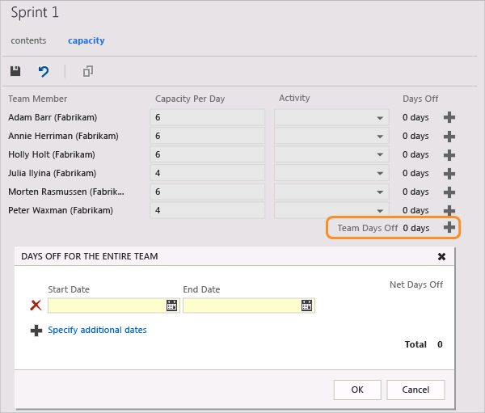

Slide 37
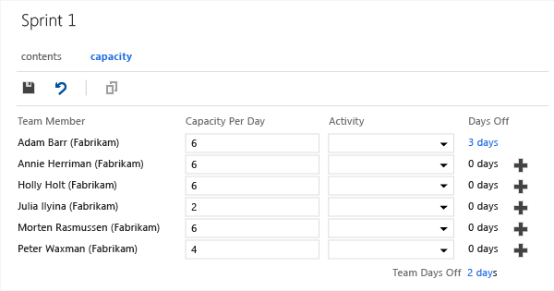

Slide 38
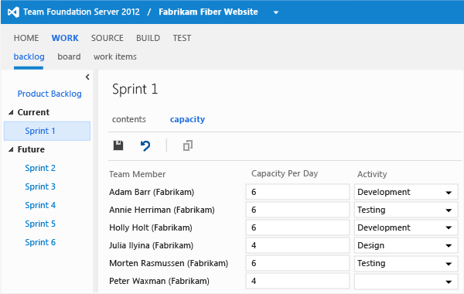

Slide 39
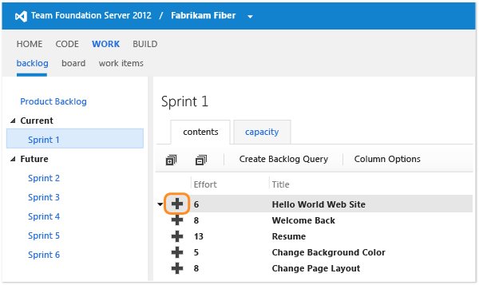

Slide 40
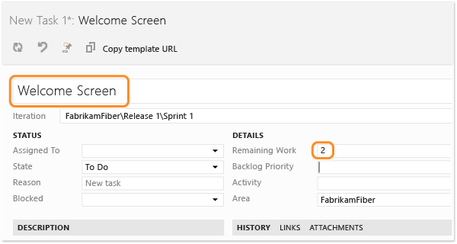

Slide 41
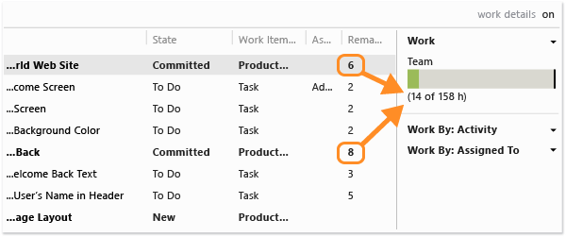

Slide 42
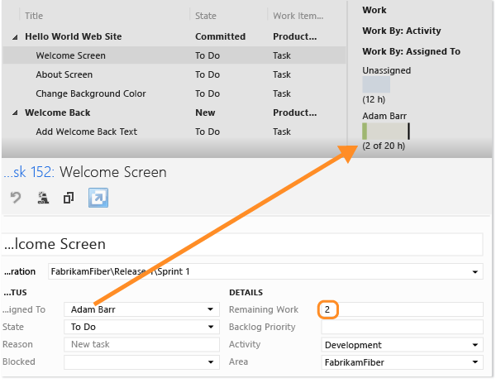

Slide 43
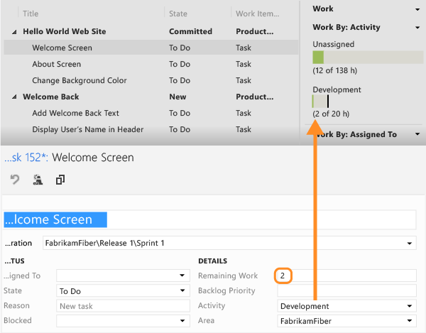


Slide 44
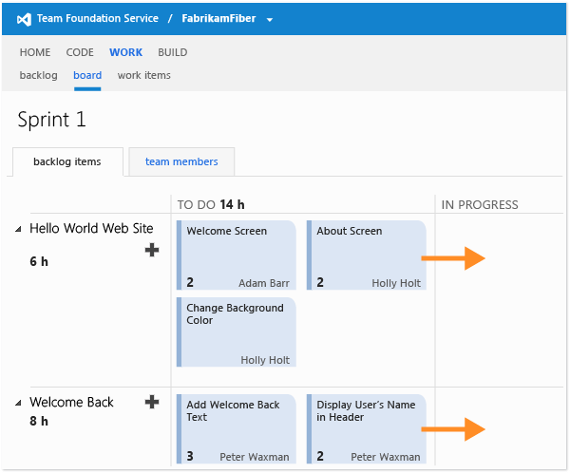

Slide 45
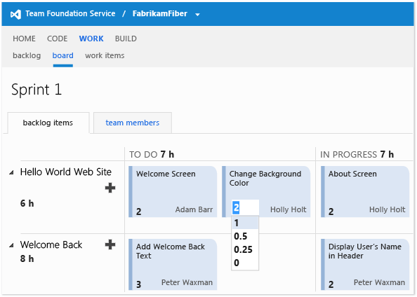

Slide 46
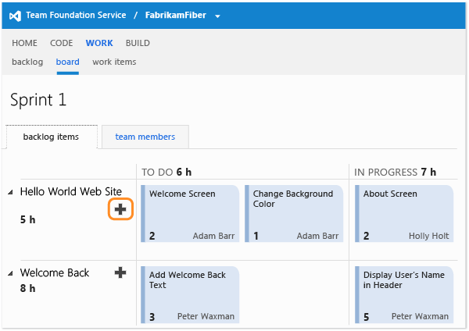

Slide 47
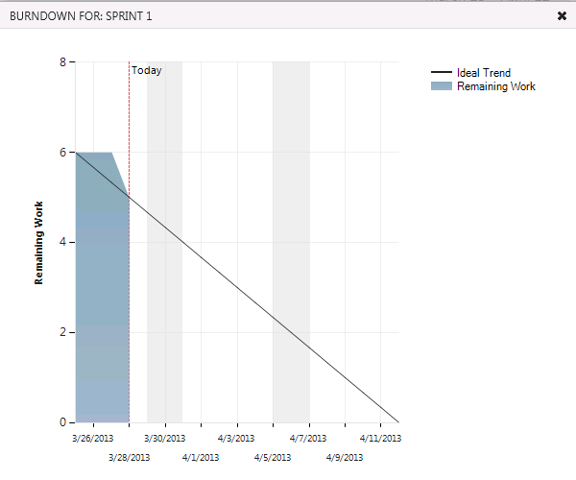

Slide 48
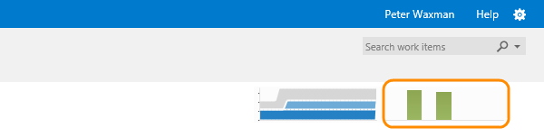
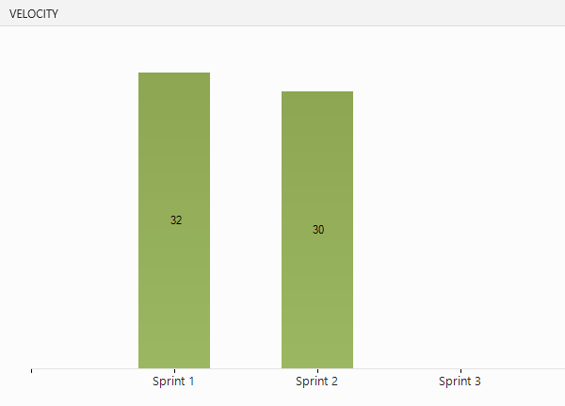

Slide 50
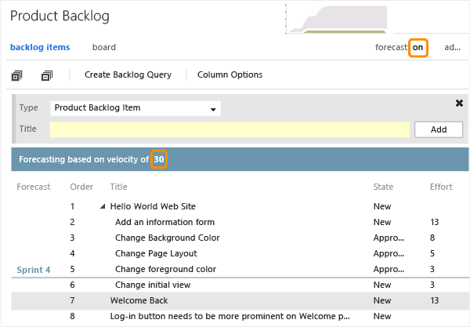

Slide 51
Powerpoint Storyboarding

Slide 52
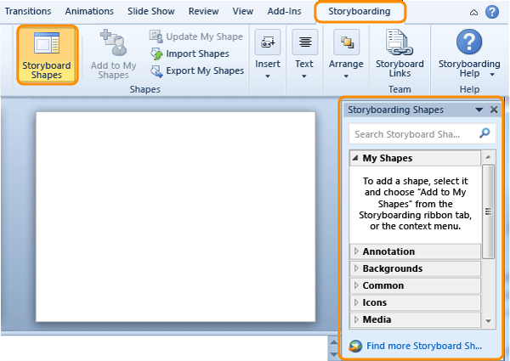

Slide 53
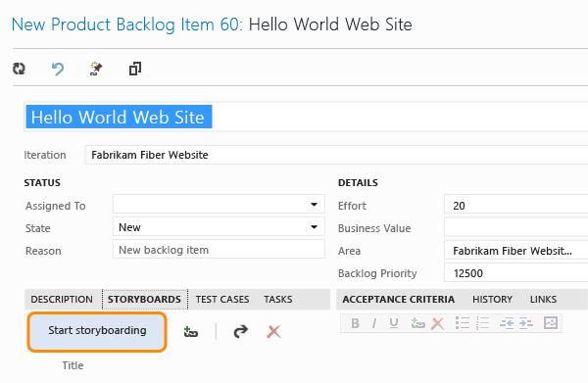

Slide 54
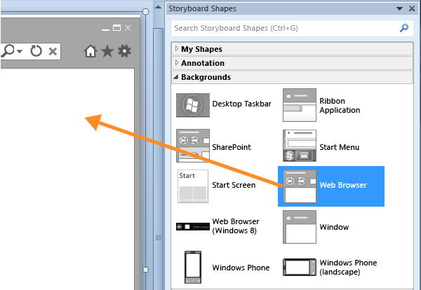

Slide 55
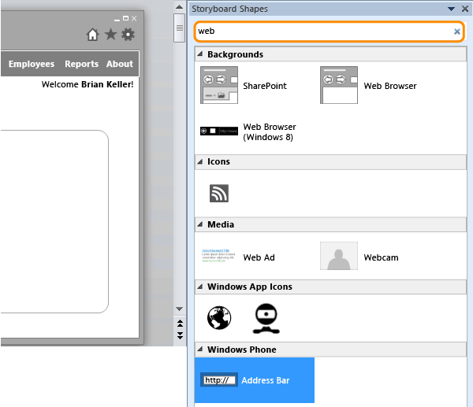

Slide 56
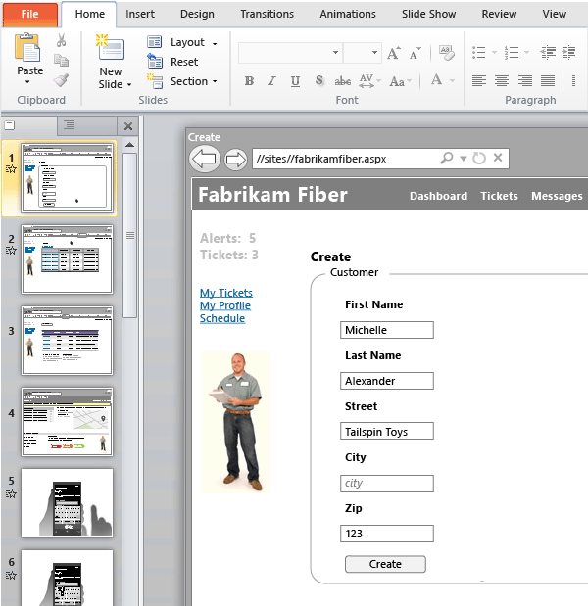

Slide 57
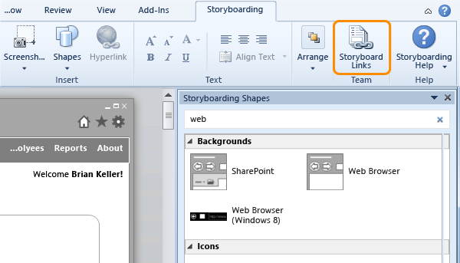

Slide 58
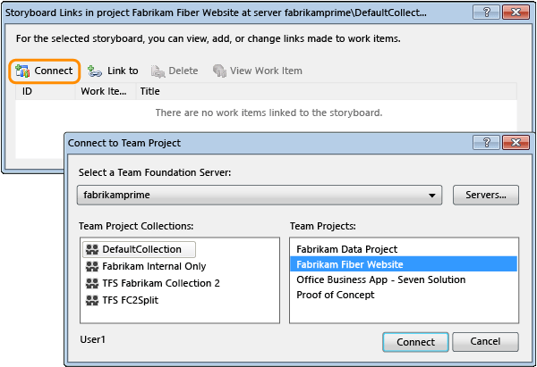

Slide 60
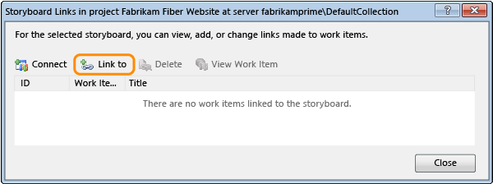

Slide 61
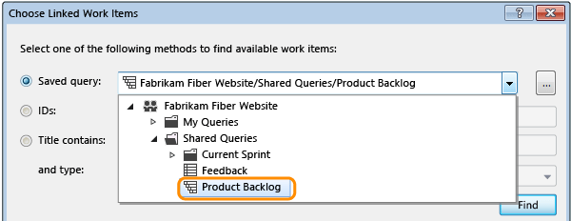

Slide 62
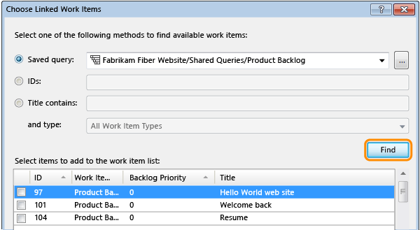
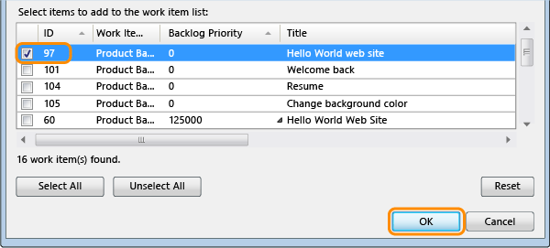

Slide 63
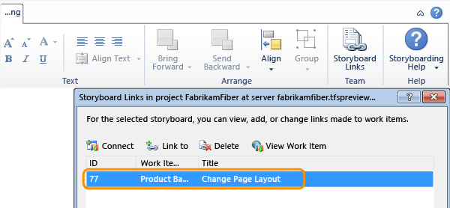

Slide 64
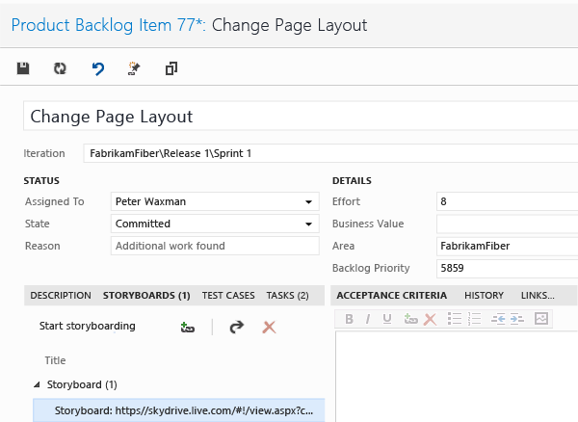

Slide 65
Request & Review FEEDBACK

Slide 66
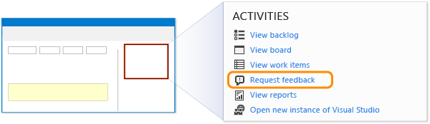
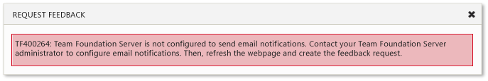
Request & Review FEEDBACK

Slide 67
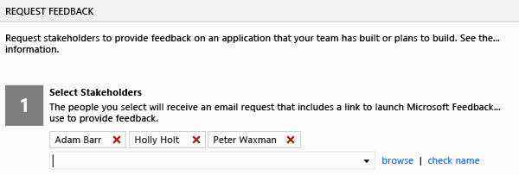
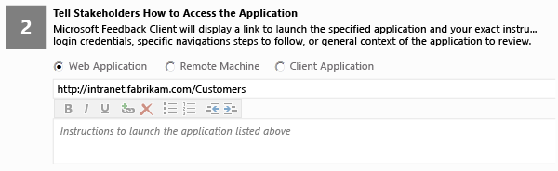

Slide 68
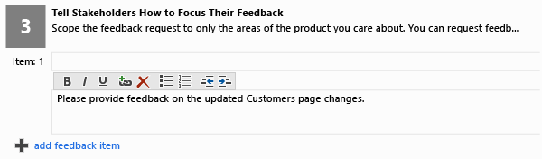
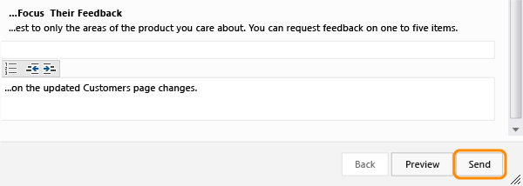

Slide 69
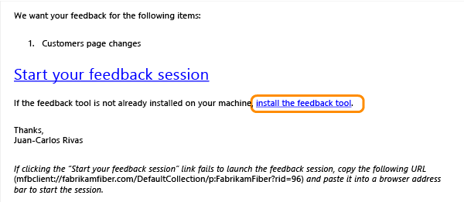
Providing Feedback

Slide 70
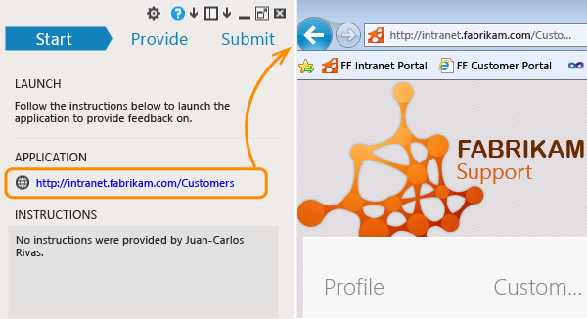
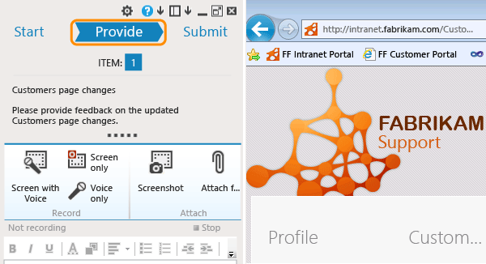

Slide 71
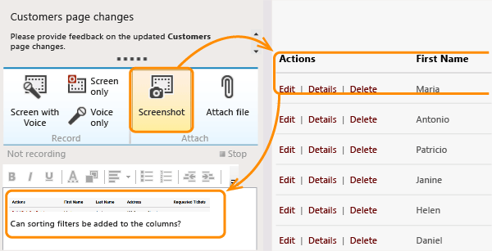

Slide 72
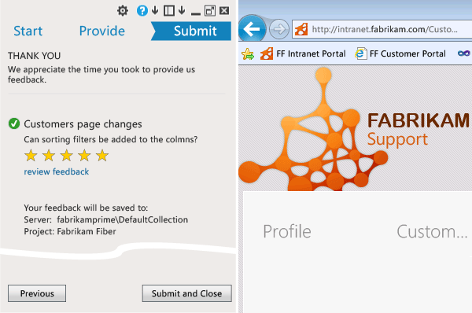

Slide 73
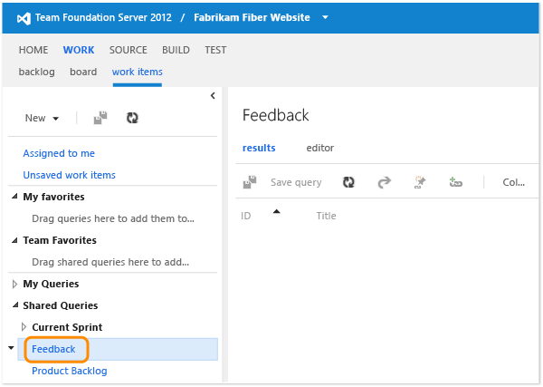
Review feedback

Slide 74
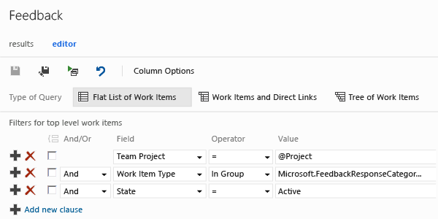

Slide 75
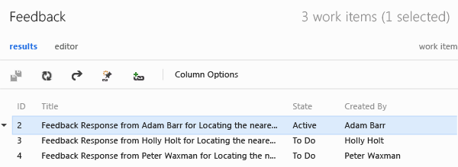

Slide 76
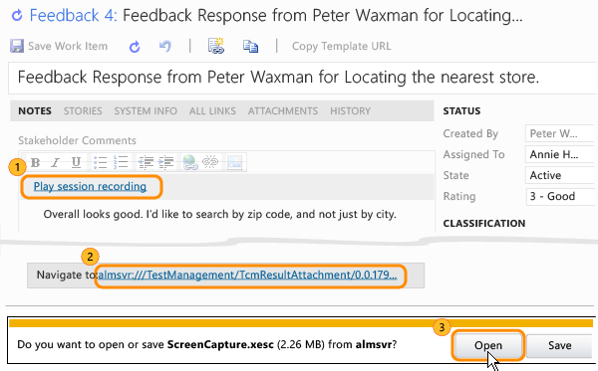

Slide 77
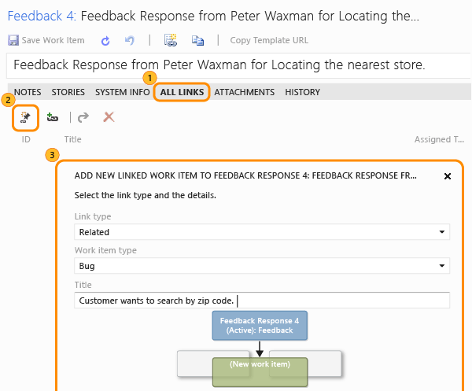

Slide 78
Modelling Applications
Browse graphs and rearrange their items to make them easier to read and to improve rendering performance.
Open and view linked model elements in work items.
Generate C# code from UML class diagrams.
Create UML class diagrams from existing code.
Import UML class, use case, and sequence diagram model elements exported as XMI 2.1 files from other tools.

Slide 79
Dependency Graph
Supported projects:
Visual C# .NET and Visual Basic .NET projects, including Windows Store apps, and assembly files (.dll or .exe).
Visual C++ projects, including Windows Store apps, that have C or C++ code (managed or native), header files (.h or #include), and binary files.
Get an overview of your solution: On the Architecture menu, choose Generate Dependency Graph, For Solution.
You get a graph that shows the top-level assemblies. You can now explore these assemblies by expanding them. Move the mouse pointer on top of an assembly, and then choose the chevron (^) button when it appears. Do the same for namespaces, types, and members to continue exploring your code.

Slide 80
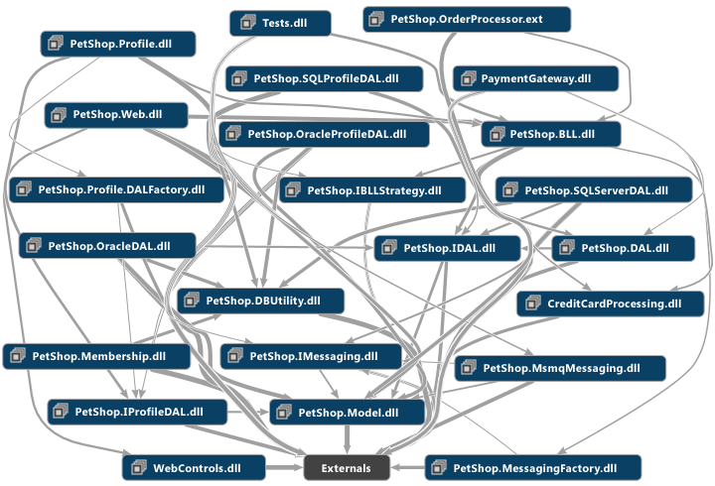

Slide 81
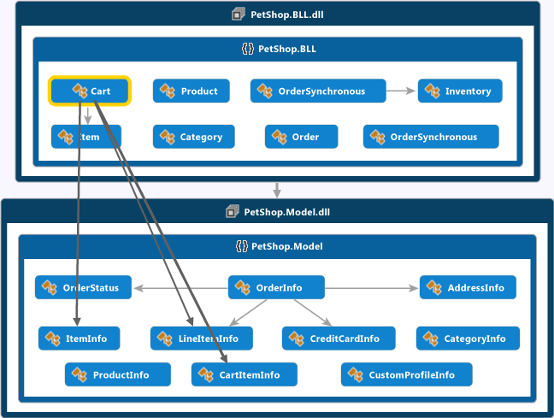

Slide 82
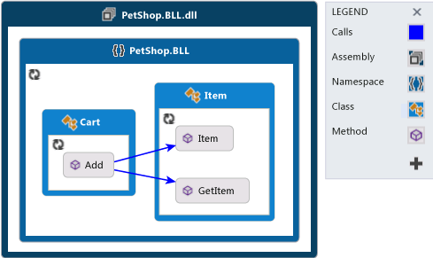


Slide 83


Slide 84


Slide 85
Modeling Tools for VS 2012
Rearrange nodes by dragging them.
Add new undefined nodes and links.
Delete existing nodes.
Add comments to the graph.
Retrieve missing members of groups.
Show hidden members of groups.
Examine dependencies that participate in a link.
Add nodes related to a node on the graph.
Change the group layout independently of the graph layout.

Slide 86


Slide 87



Slide 88



Slide 89


Slide 90


Slide 91


Slide 92


Slide 93


Slide 94


Slide 95


Slide 96


Slide 97


Slide 99
Developing applications and collaborating more effectively as a team
Track tasks and boost productivity by using an enhanced interface.
Organize upcoming, ongoing, and suspended work while increasing transparency and reducing the impact of interruptions.
Work more efficiently in a version-controlled codebase.
Organize your work, reduce the impact of interruptions, and manage shelvesets and changesets.
Conduct and track code reviews by using new tools.
Perform unit testing by using a dedicated tool.
Test code as part of your workflow. For more information, see Running Unit Tests with Test Explorer.
Find duplicate code so that you can refactor.
Compare code versions by using an enhanced diff tool.
Work offline: Work in local workspaces either inside or outside of Visual Studio, even when you're not connected to Team Foundation Server.

Slide 100


Slide 101


Slide 102


Slide 103


Slide 104


Slide 105


Slide 106


Slide 107


Slide 108


Slide 110


Running Unit Tests with Test Explorer

Slide 111


Slide 112


Slide 113




Slide 114



Slide 115


Slide 116


Slide 117


Red, Green, Refactor...

Slide 118



Slide 119



Slide 120


Slide 122
Automating and debugging builds
Run, monitor, and manage builds by using an enhanced interface.
Run automated builds from Team Foundation Service.
Define gated check-in build processes that support multiple check-ins.
Run native and third-party framework unit tests in your build process.
Debug your build process more easily.

Slide 123


Slide 124


Slide 126
Improving Quality with Visual Studio Diagnostic Tools
Debug Your App by Recording Code Execution with IntelliTrace
Verifying Code by Using Unit Tests
Analyzing Application Quality by Using Code Analysis Tools
Analyzing Application Performance by Using Profiling Tools
Concurrency Visualizer
Measuring Complexity and Maintainability of Managed Code
Finding Duplicate Code by using Code Clone Detection
PreEmptive Analytics for Team Foundation Server
PreEmptive Dotfuscator and Analytics CE
Profile Guided Optimization in the Performance and Diagnostics Hub

Slide 127
Deploying Applications and Components
Publish to the cloud
Publish a Windows Store app
Publish a Windows Phone app
Deploy a LightSwitch application or service
Publish an app for SharePoint
Publish an app for Office
Deploy a WCF service
Deploy an OData service
Deploy a desktop application
Create a setup program
Deploy a Visual C++ application
Deploy an application for testing
Install prerequisites - Bootstrapper

Slide 129
Thank you
Sheriff M
http://sheriffm.com

